Slide 1



FEE

Slide 2
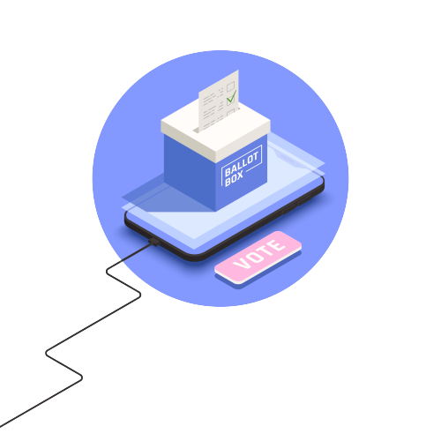

FEE
LED ROULETTE
Name : PRINCE M. MALL
Enrollment No : 22002170110069
Roll NO : 70
Batch & Div : D3

Slide 3

LED ROULETTE
TEAM

Slide 4
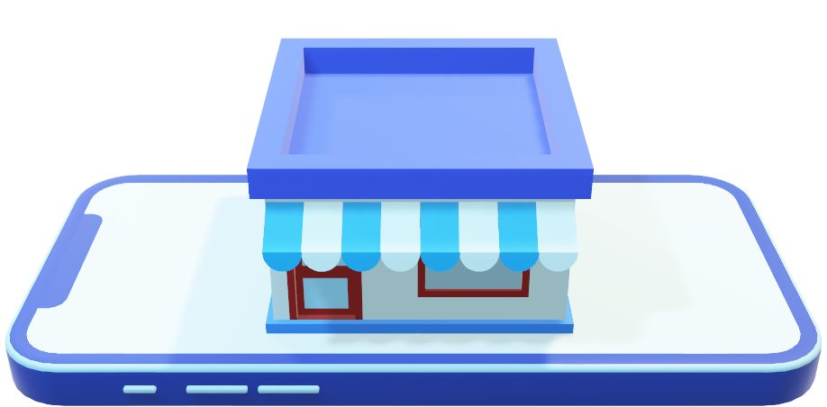
Online shopping system
TEAM
A
64
Patel
Rudra
22002170210088
D3
70
Prince mall
22002170110069
3A
70
Prince mall
22002170110069
3A
70
Prince mall
22002170110069
3A

Slide 5
TEAM
A
B
66
Patel
Meet
22002170210078
D3
70
Prince mall
22002170110069
3A
70
Prince mall
22002170110069
3A

Slide 6
TEAM
A
B
C
70
Mall
Prince
22002170110069
D3
70
Prince mall
22002170110069
3A

Slide 7
TEAM
A
B
C
D
86
Chauhan
Ajay
22002170210008
D3

Slide 8
TEAM
A
B
C
D
E

Slide 9
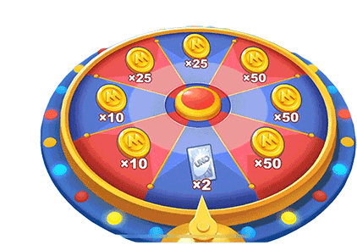
Introduction
The LED Roulette project is an engaging electronic circuit that simulates the spinning motion of a roulette wheel using LEDs (Light Emitting Diodes).
It’s can be used as dise.
This circuit resembles the functioning of roulette wheel game , hence name is given to it.

Slide 10
Components Used
555 Timer IC
4017 IC
PNP Transistor (BC557)
10 LED’s
Resistors: 330R, 10K, 2 x 3.3M, 10M
Capacitors: 1uF, 100n
Few Connectors
(5-12)V Power Supply

Slide 11
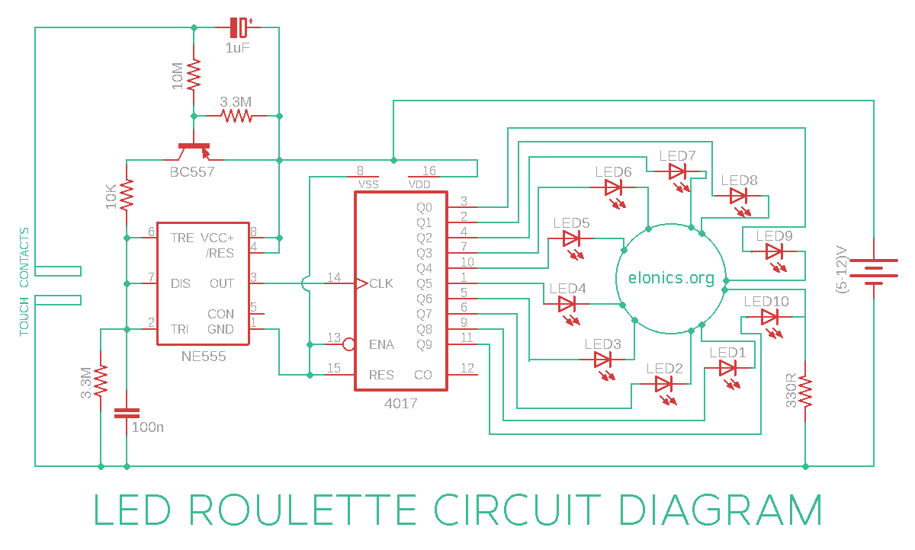
Circuit Diagram
Introduction

Slide 12
Working Video

Slide 13
Advantages and disadvantages
Energy Efficiency : LEDs are energy-efficient, consuming less power compared to traditional lighting sources.
Durability : LEDs have a longer lifespan
Color Options: LEDs can emit various colors lighting effects.
Low Heat Emission: LEDs produce very little heat, reducing the risk of overheating
Lighting: LEDs turn on instantly, without the warm-up time required by some other lighting technologies.
Cost : Initially, LED components and controllers can be more expensive
Complexity: Setting up an LED roulette project can be more complex
Limited Brightness: Some LEDs may have limited brightness compared to high-intensity traditional lighting sources.
Voltage Sensitivity :

Slide 14
Application
In electronic gaming circuits
As a random number generator
In touch intuitive decorative lighting setups

Slide 15
T
H
A
N
K
Y
O
U

